Slide 1
Semantic Technologies Presentation
Emenike Onyebuchi Ifeatu
MSc. Computer science

Slide 2
About me
MSc. Computer Science
Anglia Ruskin University, Cambridge.

Slide 3
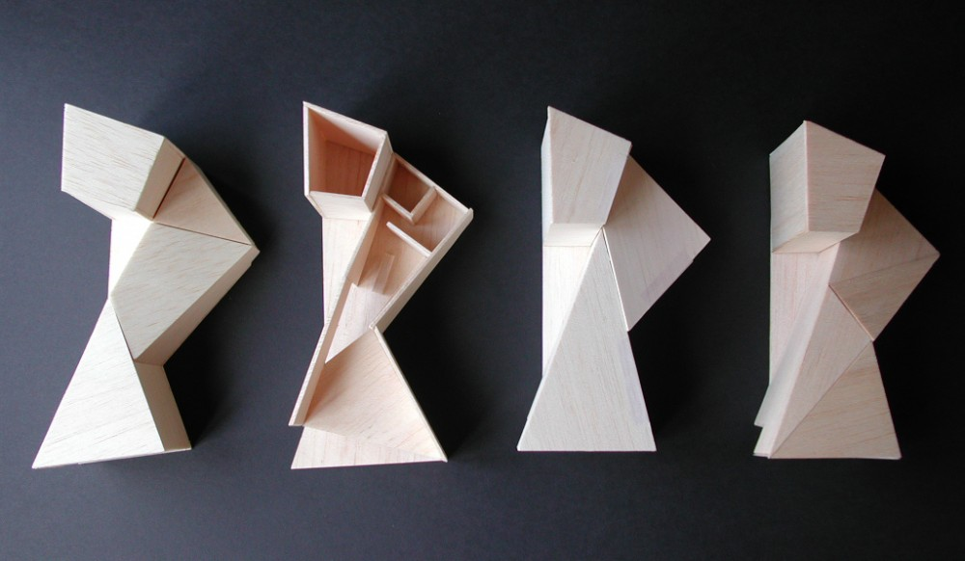
Model and design

Slide 4
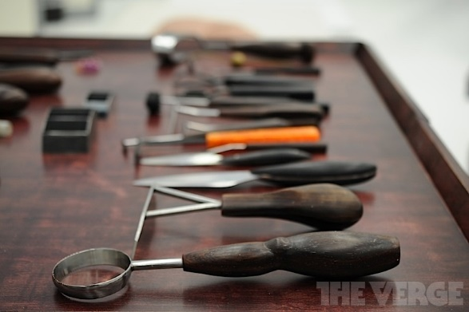
Semantic Application Design Libraries
SPARQL Endpoint - Jena Fuseki
Java SPARQL Library - Jena
PHP SPARQL Library - sparqllib
C# SPARQL Library - dotnetrdf
Python SPARQL Library - SPARQLWrapper

Slide 5

Why use Semantic web?
Data is structured easy for machine to read.
Contains relationship between various data.

Slide 6

Future of semantic Ontology
Big data
Machine Learning
Computational Linguistics
Natural Language Processing
IoT
Artificial Intelligence

